Slide 1
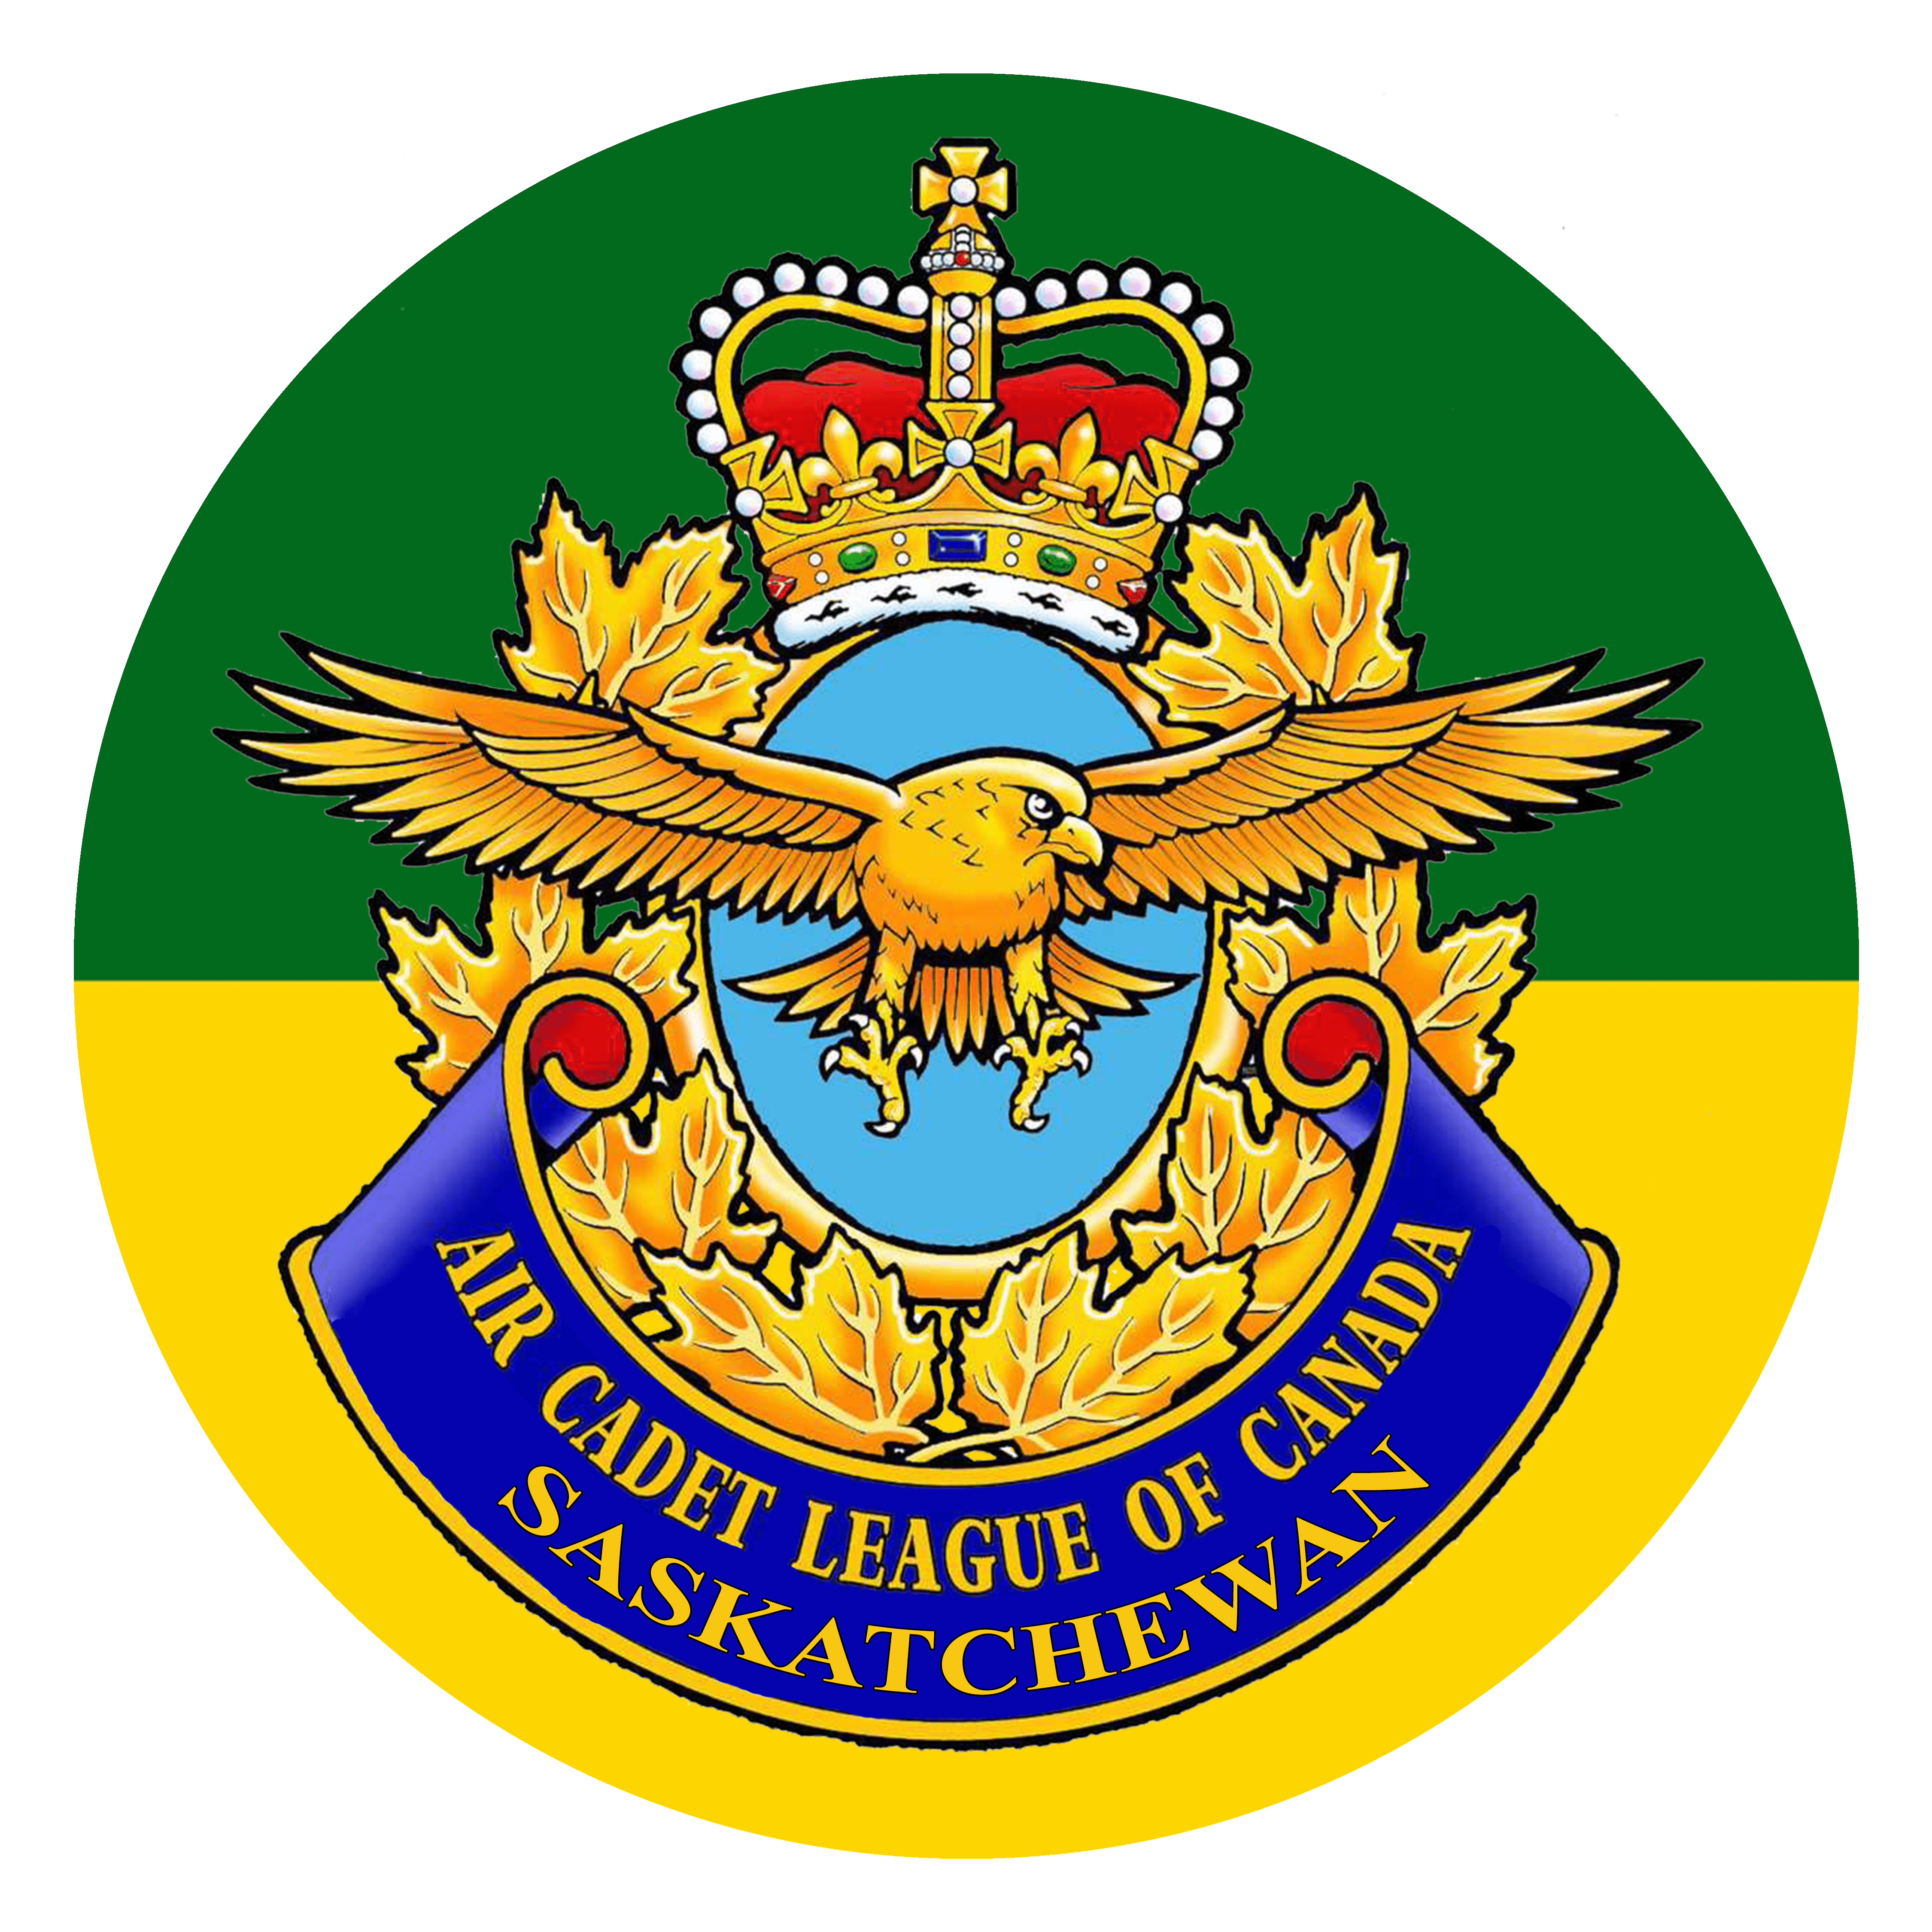
Royal Canadian Air Cadets
Saskatchewan Air Cadet League (SKACL)
To Learn • To Serve • To Advance
www.SKACL.ca

Slide 2
Air Cadet League of Saskatchewan Cadet Recruitment Video
https://www.youtube.com/watch?v=57UnC1R0jAw

Slide 3
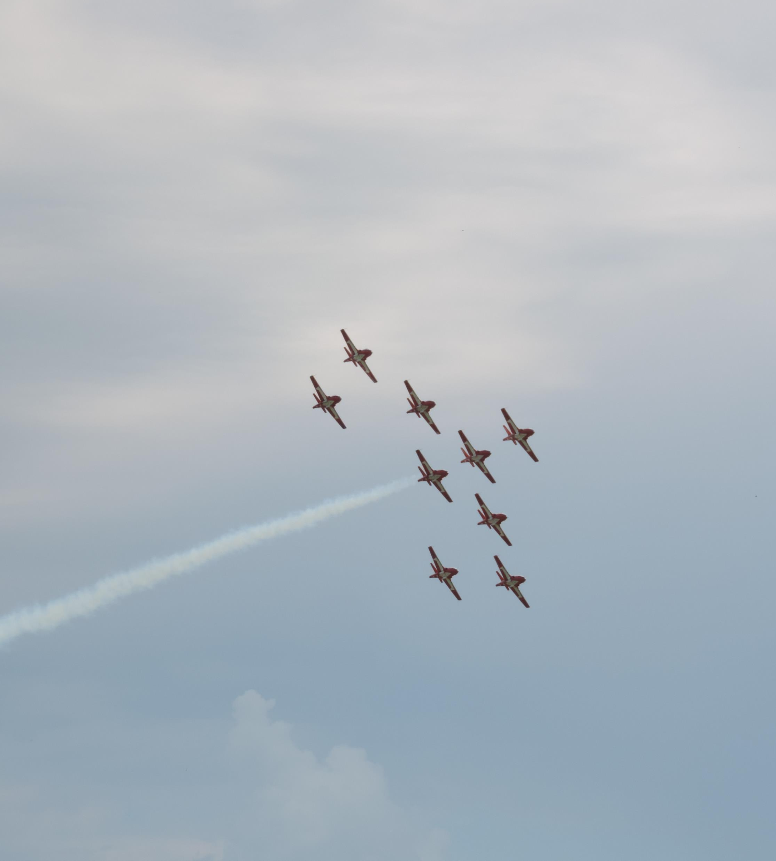
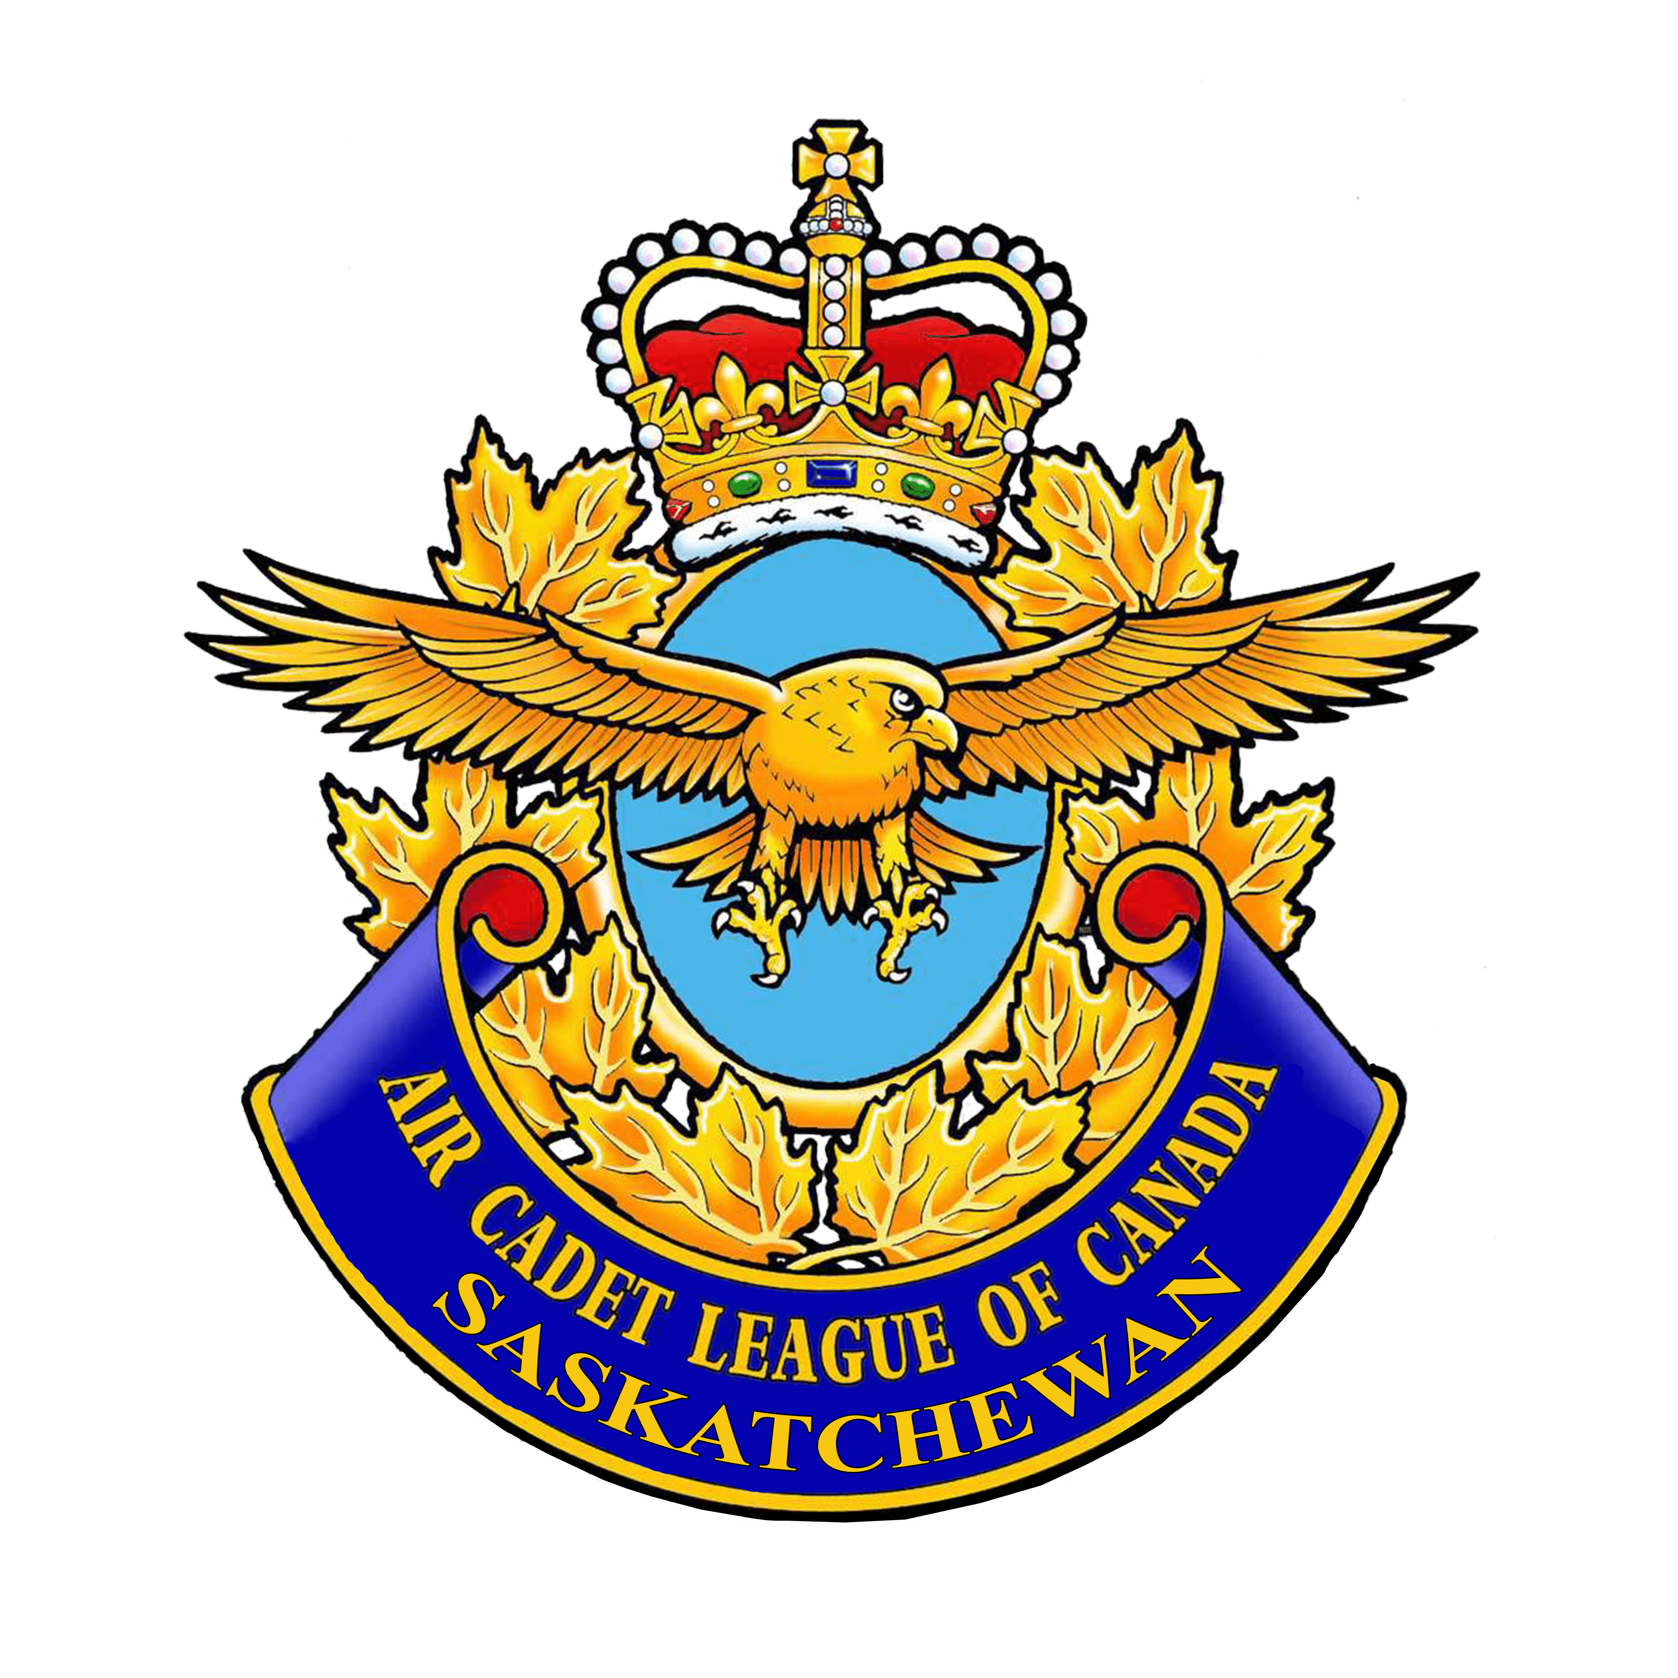
Agenda
About Air Cadets & History
Air Cadet League (ACL)
Department of National Defence (DND)
What Air Cadets do
Uniform
Ranks
Squadron Organizational Structure
Famous Cadets

Slide 4
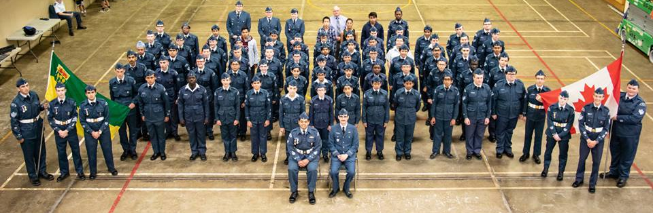
What are Air Cadets?
Canadian national youth program for young individuals aged 12 to 18
Two groups fund and support this program:
Department of National Defense
Air Cadet League of Canada (and provincial committees)
Cadet program (Air, Sea, Army) forms the largest federally funded youth program in Canada
Cadets are not members of the military and are not obliged to join the Canadian Forces.

Slide 5
Aims
Develop in youth the attributes of good citizenship and leadership
1
Promote physical fitness
2
Stimulate the interest of youth in the air element of the Canadian Forces
3

Slide 6
History
1941 – Air Cadet League and program formed to train pilots for WWII
1942 – 135 squadrons with 10,000 cadets
1943 – 315 squadrons with 23,000 cadets
1944 – 374 squadrons with over 29,000 cadets, 1750 officers/instructors, 2,000 civilians
1946 (post war) - Program expanded to include citizenship, leadership, physical fitness, flying scholarships, and summer camp opportunities
1990s – total of 1 million young Canadians have participated in the Air Cadet training program
Present – Over 450 active squadrons across Canada, 50,000 Canadians involved, 26,000 Air Cadets

Slide 7
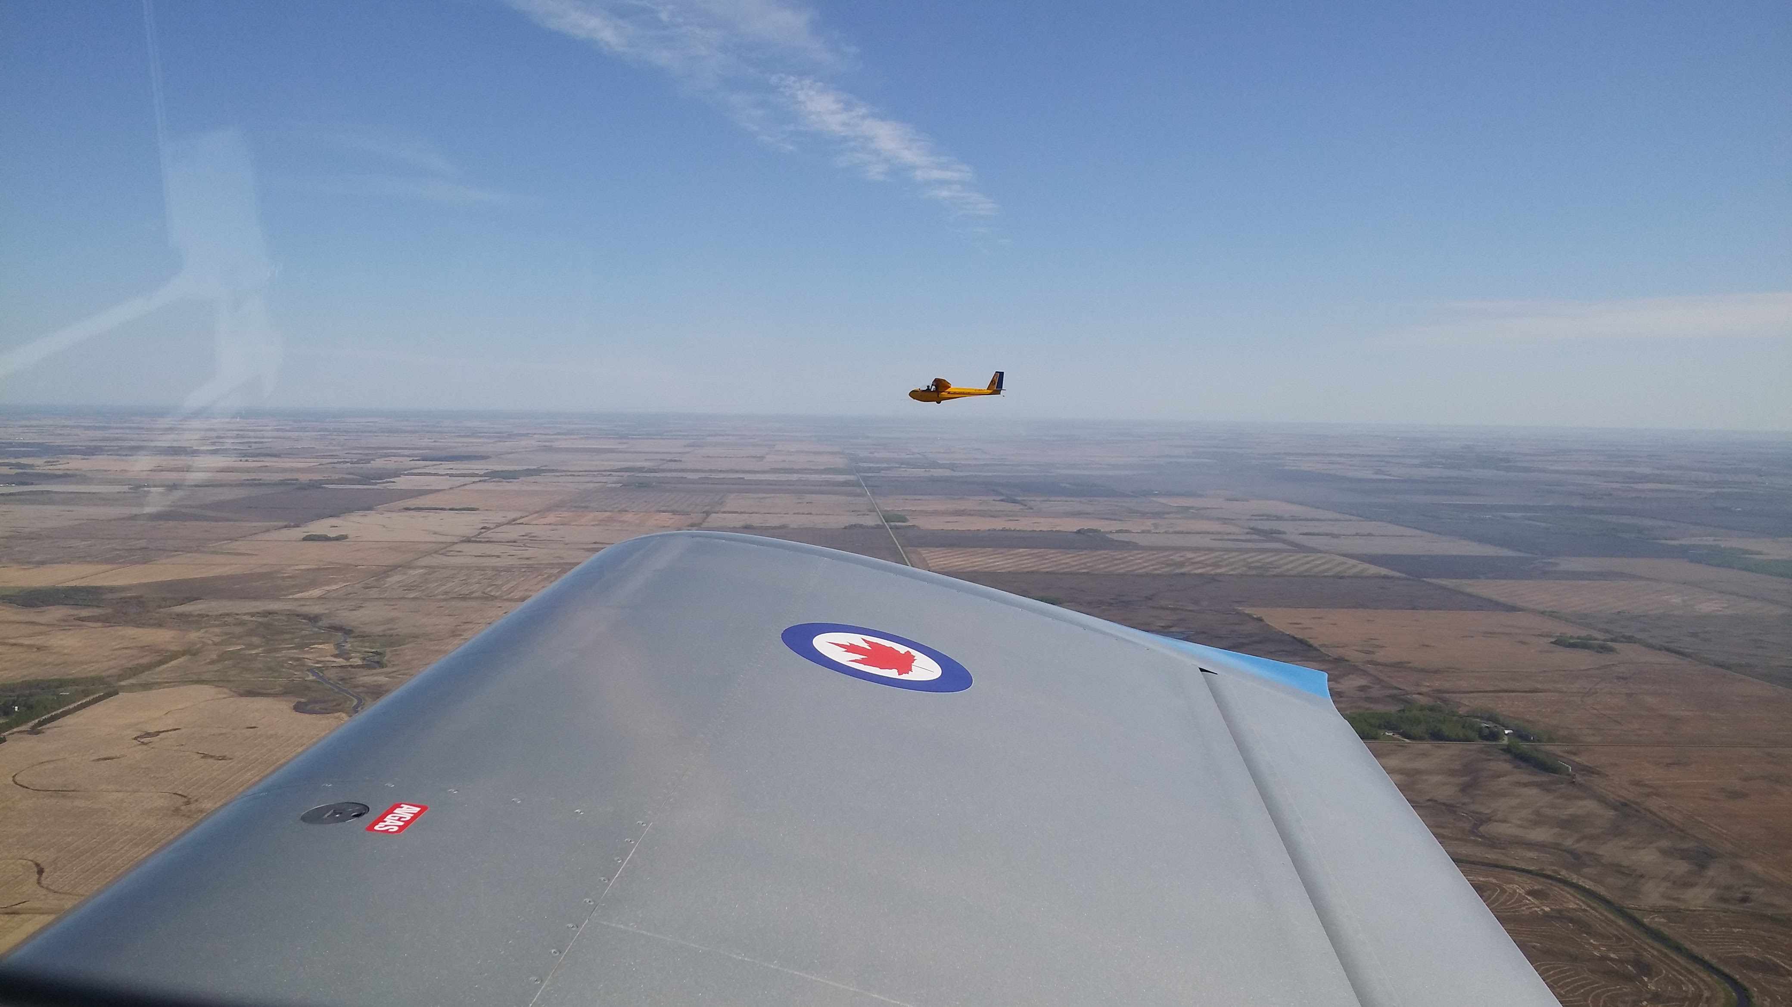
Air Cadet League (ACL)
Civilian, non-profit, volunteer led organization that works alongside the Department of National Defence to deliver the Royal Canadian Air Cadet program
Mission Statement: To influence the development of Saskatchewan youth to become excellent citizens through programs which provide education, recreation, leadership skills, and aviation exposure

Slide 8
Air Cadet League (ACL) Levels
National
Provincial
Own Air Cadet Gliders & tow planes (Fun Fact: Air Cadet gliding program is the largest in the world!)
Camp Saskadet, Effective Speaking Competition, Curling, Summer Training board interviews, etc.
Local
Squadron Sponsoring Committee (SSC) at each squadron – composed of parent volunteers (parents are encouraged to join)

Slide 9
Department of National Defense (DND)
Officers in the squadron are Canadian Forces members (CIC - Cadet Instructor Cadre) – parents are eligible to join

Slide 10
What Air Cadets do
Regular weekly parades/classes, and occasional weekend activities
Classes, Tours, Sports, Survival Weekends (FTX), competitions, fundraising activities
Summer Training Courses
Optional Activities:
Effective Speaking
Marksmanship
Biathlon
Curling
Drill & Flag Party
Band & Music
Participation in squadron fundraising activities is expected to fund special and optional activities, parents are encouraged to become volunteers.

Slide 11
What to wear
All Cadets will be given a uniform free-of-charge
Classes on proper uniform wear and maintenance will be given
What to wear before uniform is given:
White long-sleeve dress shirt
Black dress pant
Black dress shoes or equivalent

Slide 12
Uniform standards, care, badge placement, etc. can be found on www.SKACL.ca

Slide 13
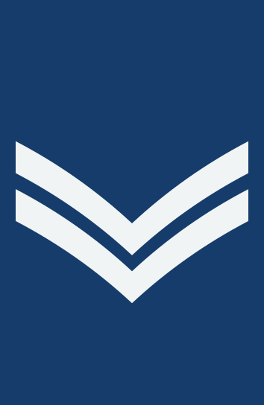
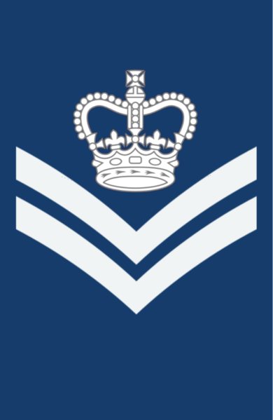
Cadet Ranks (1)
Air Cadet (AC)
Leading Air Cadet (LAC)
Corporal (Cpl)
Flight Corporal (FCpl)

Slide 14
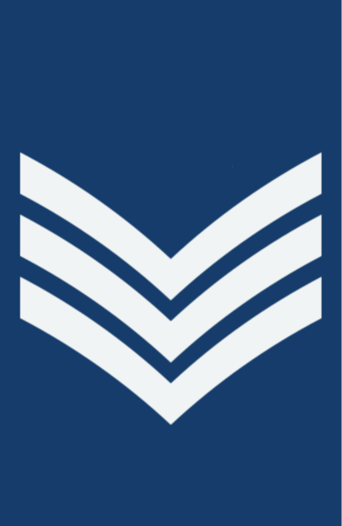
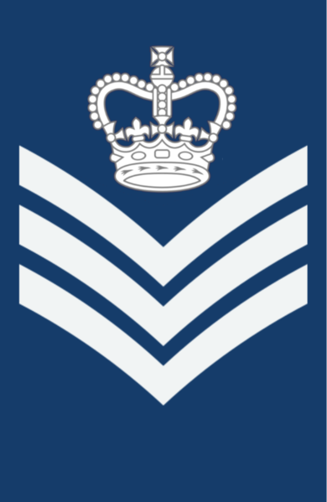
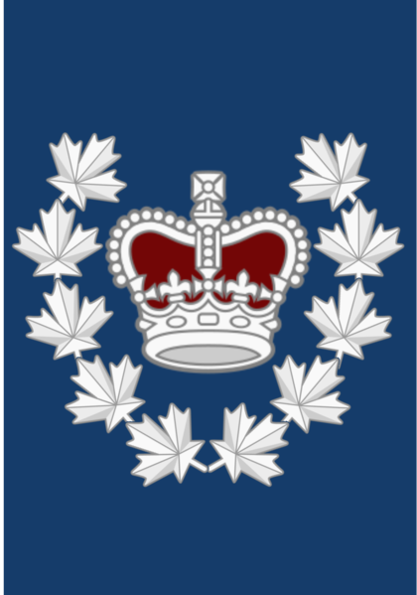
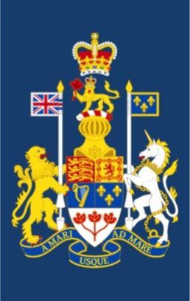
Cadet Ranks (2)
Sergeant (Sgt)
Flight Sergeant (FSgt)
Warrant Officer
2nd Class (WO2)
Warrant Officer
1st Class (WO1)

Slide 15
Officer Ranks (Present in most squadrons)
Officer Cadet
(OCdt)
2nd Lieutenant
(2Lt)
Lieutenant
(Lt)
Captain
(Capt)
Major
(Maj)

Slide 16
Squadron Organizational Structure
Commanding Officer
Training Officer
Admin Officer
Supply Officer
Cadet Commander - Warrant Officer 1st Class (WO1)
Other Officers
Warrant Officer 2nd Class (WO2)
Flight Sergeants (FSgt)
All Other Cadets (AC, LAC, CPL, FCPL, SGT)

Slide 17
Famous Air Cadets
Chris Hadfield – Astronaut (First Canadian International Space Station Commander & First Canadian to walk in space)
Marc Garneau – First Canadian astronaut
Maryse Carmichael – First female snowbirds pilot and then commander
Gordon Barnhart - Lieutenant Governor of Saskatchewan
Jim Carrey - Actor
Regan Wickett - Former snowbirds pilot (former cadet at 107 Spitfire Squadron in Saskatoon)
Ray Hnatyshyn - former Governor General of Canada (former cadet at 107 Spitfire Squadron in Saskatoon)

Slide 18
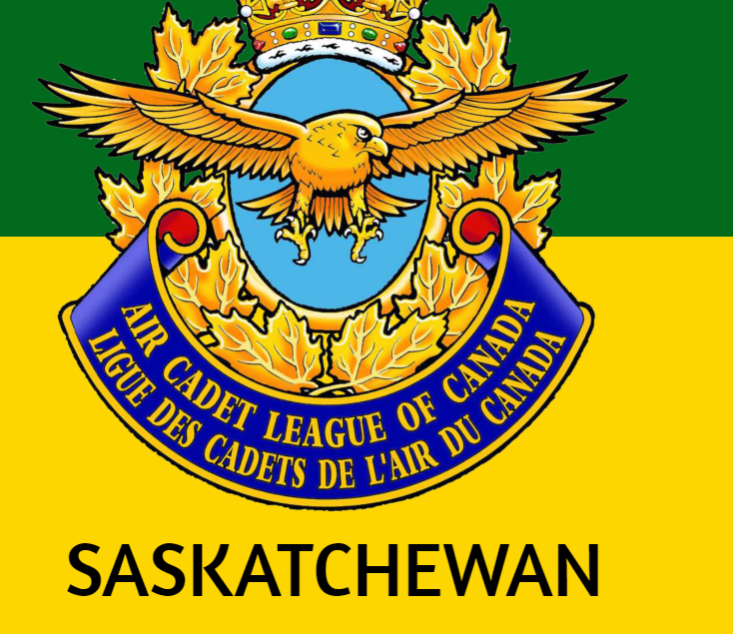
Find us online
Website: www.SKACL.ca
Facebook & Instagram:
Air Cadet League – Saskatchewan
@acl.sask

